Slide 1
RFID based Intelligent Trolley using ZIGBEE
Proposed by,
Krutika Thakur-20
Meeta Vadhel-21
Nikhil Vaze-22
Aniket wani-23
Guided by,
Prof. Rupali Advilkar
1

Slide 2
Abstract
This system is designed to minimize the billing time, hence increasing the speed of buying process.
System consists of an RFID based trolley which communicates with the billing counter wirelessly using a ZIGBEE(NRF24L01).
Each trolley will consist of a similar type of hardware with unique trolley address.
The billing counter can at any point of time inquire about the current items present in the trolley.
LCD on the trolley acts as a user interface to simplify the process.

Slide 3
Introduction
Scanning the items on the bill desk consumes time of all the customers standing in a Queue. Due to the long billing time customer avoids to visit the shopping mall, hence reducing the business.
On number of times, customer needs to calculate the total amount before the billing, which seems to be tedious task when the discount is mentioned in percentage.
As we are living in the 21st century in the era of automation and technology, wastage of time can not be afforded.
Hence we are developing the intelligent trolley that will make shopping experience more efficient, convenient and comfortable .
Developing the ways of modularising the life in terms of technology.
Introducing automation in day-to-day life

Slide 4
Software Requirements:
Windows XP / Vista / 7
Visual studio 10
Microsoft office access database
Keil uV3 for microcontroller programming
EAGLE for PCB designing

Slide 5
Hardware requirements:
RFID reader EM-18
Zigbee NRF24L01
Micro controller 89s52
LCD
Keypad
Power supply
Switches

Slide 6
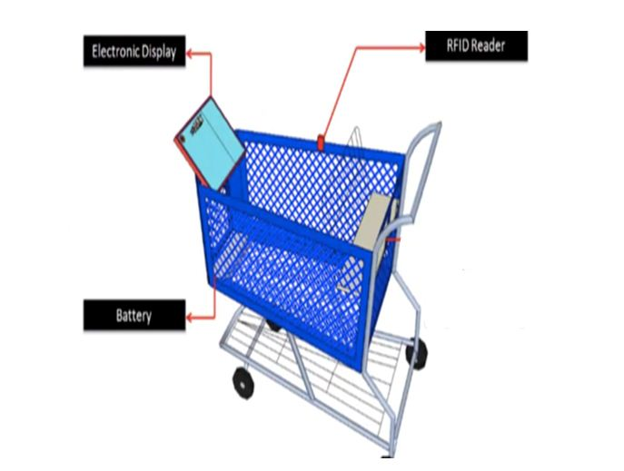
Proposed Model

Slide 7

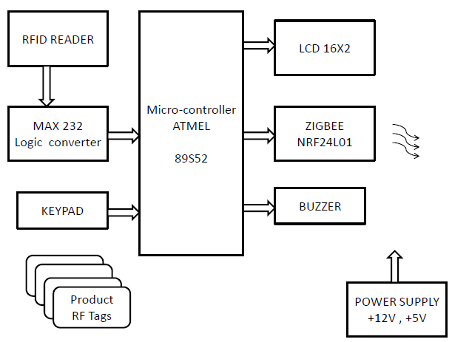
Block Diagram

Slide 8

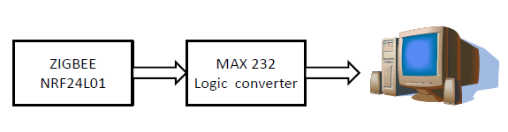
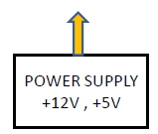
Block Diagram

Slide 9
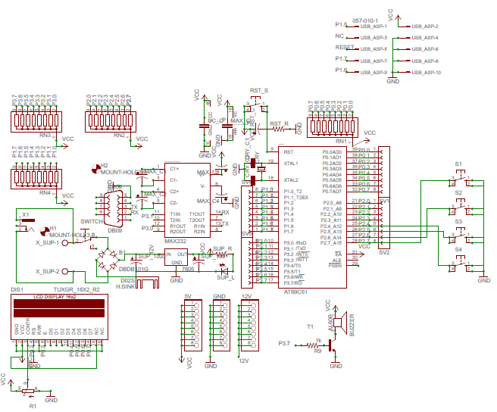
Circuit Diagram

Slide 10
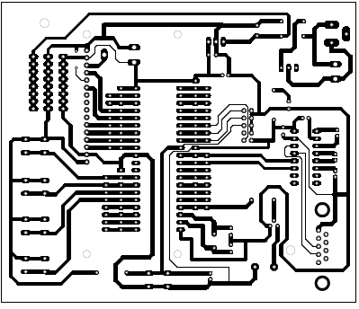
PCB Layout

Slide 11
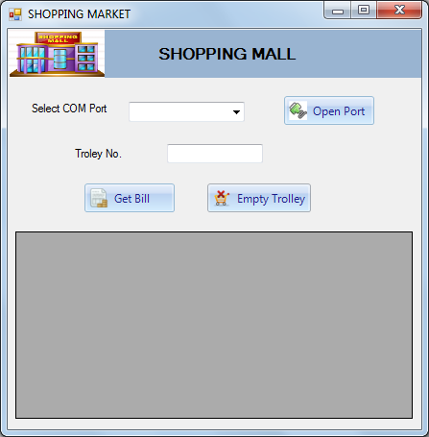

Slide 12
WORK PLAN
Sem VII
Hardware implementation
Eagle designing
Pcb layout
Sem VIII
Troubleshooting and testing.
Software implementation.
Analysis and optimization.
Integration of the system in further applications if possible.

Slide 13
Literature Survey
Existing system | Product system
Manual billing. Use barcode for billing. Human staff is needed for billing. Low product cost but overall expenses are much high. Difficult to track the product. Getting product information is difficult & time consuming. It does not disclose any automatic way of indicating to the shopper how the total bill is affected as objects are added or removed from the car. | Automatic billing. Use RFID TAG for billing. No need of any staff for billing. Product is little expensive but overall expenses is much low. Easy to locate/track the product. Getting product information is easy and no extra time needed. LCD display is present which will show the updated bill every time the shopper add or remove any object from the cart.

Slide 14
Conclusion
With reference to various sources, we studied different technologies required in the project and complied them in the form of block diagram and review paper.

Slide 15
Thank You

